Slide 1
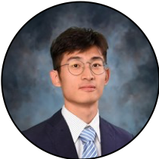
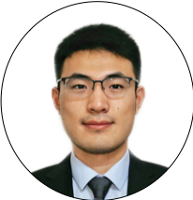
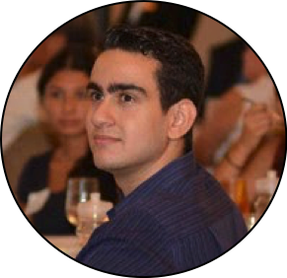
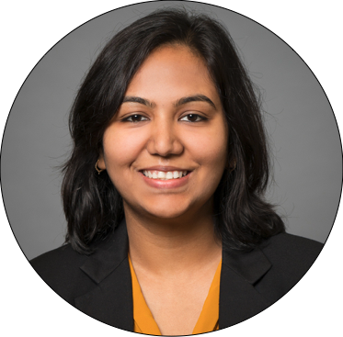
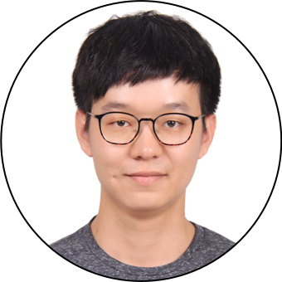
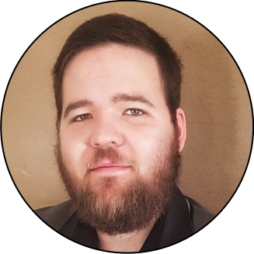
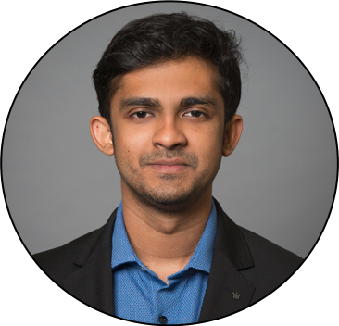
Cornell Tech & Samsung
Team BlueMoon
Jiacheng Dong
ORIE
James Chen
ORIE
Christian Rodriguez
CS
Mansi Garg
MBA
Harry Li
ORIE
Frans Fourie
ECE
Alan Abraham
MBA

Slide 2

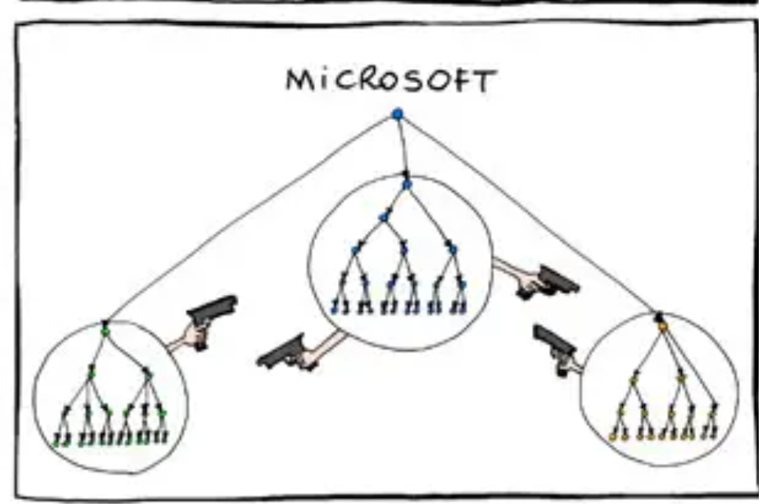
Multi Conglomerate Firm
$208 Billion Revenue, 320,000 employees
17% of South Korea’s GDP in 2019
We work with NYC AI research center
SAMSUNG
Notes:
Samsung started as a grocery trading firm, and now employs a quarter million people around the world.
To put it in context, they contributed to 17% of South Korea’s GDP in 2019!

Slide 3
Opportunities
Samsung is a seniority-oriented big-co which needs a way to allow free-flow of ideas as it tries to shift to a startup culture
Notes:
Samsung’s historically authoritarian ways have helped it make decisions quickly and keep up with its Japanese competitors.
Recently though they have had sluggish growth and are struggling to innovate.This is why Samsung is trying to learn and adopt principles from western companies operating in a lean start-up mode.
Since 2016, the senior management have been implementing systematic cultural changes, such as calling each other by their name rather than job titles such as Manager or Director, holding more online internal discussions, why we have the AI centre in NYC, and flexible working hours which is probably the most important factor in attracting millenials like us.

Slide 4
Challenges
Changing Company Culture Requires a Movement, Not a Mandate
Notes:
But culture change can’t be achieved through press statements or top-down mandates. See Samsung is an old company, and an immensely big one. Levelling a seniority-based corporate hierarchy, and ending persistent patriarchy that is decades old will take time. Culture lives in the collective mindsets of people and it’s their shared understanding of “how things are done around here.” Changing that is a challenge.
Culture lives in the collective mindsets of people. Changing it requires a movement and not press statements or top-down mandates.

Slide 5
Hypothesis
In order to create a start-up culture, we need to enable free-flow of ideas.

Slide 6
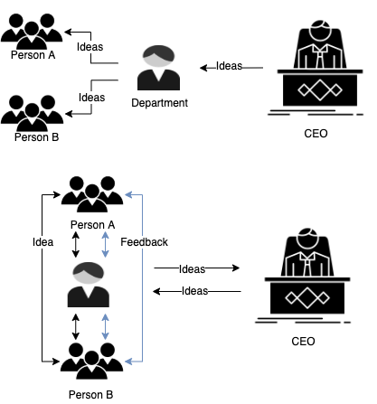
What we will do
Problem - Boundaries for Ideas
Cultural
Geographical
Structural
Lingual
Solution - An Idea Validation Platform
Anonymous & Expertise-based
Online
Flat-hierarchical voting
Auto-translate
Notes:
Explain the product
What are the features of our MVP that will fulfill this goal
Anonymous
Online
allowing flat hierarchical voting + expertize- based segmentation
auto translate
Mockup of MVP
FJ

Slide 7
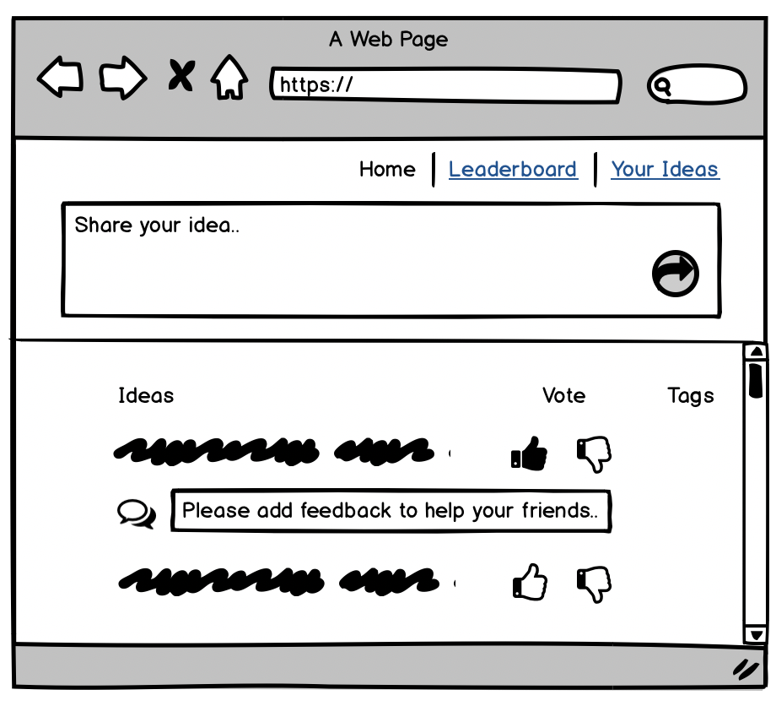
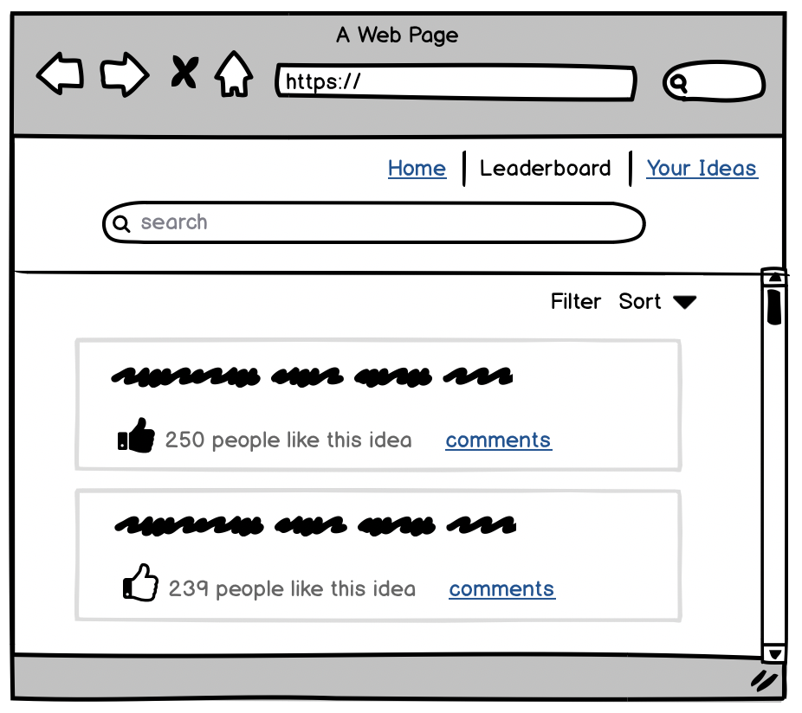
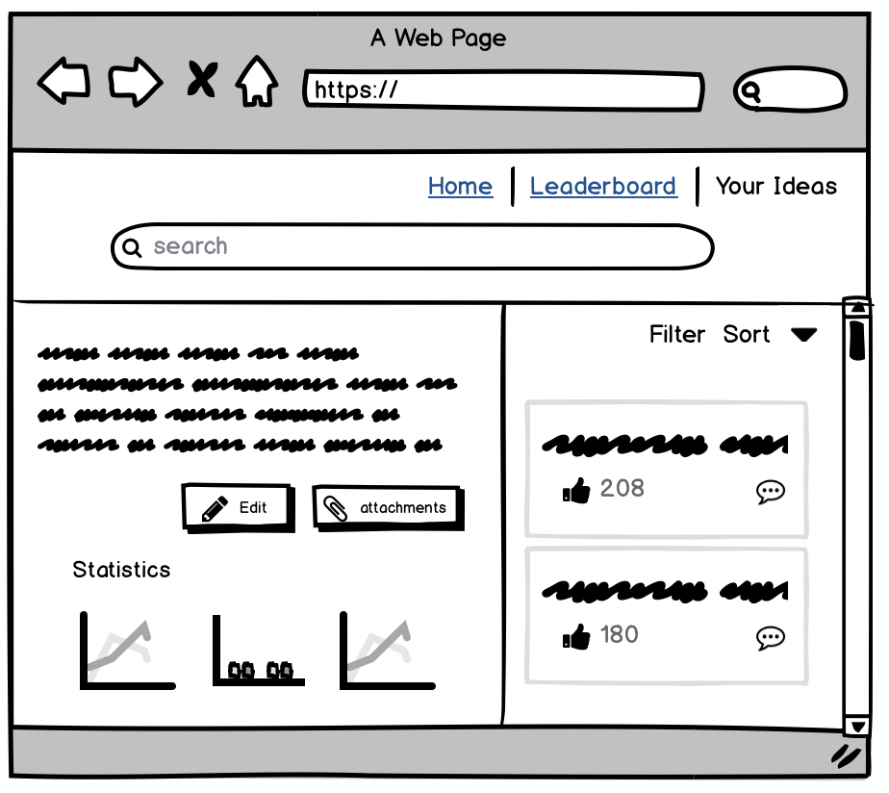
Samsung Reach
Notes:
Explain the product
What are the features of our MVP that will fulfill this goal
Mockup of MVP
FJ

Slide 8



Potential risks
Participation
Awards
Anonymity
Notes:
Our major risks consist of our product's usage. This product is meant to transform the company culture, so we expect some resistance. We are concerned that usage will remain isolated in Samsung's more-liberal departments or that good ideas from the platform would go unrewarded, defeating a key value propositions. We also don't know how best to encourage employees to participate. We are currently wondering whether propositions and votes should be made anonymously and how to show employees both relevant and new ideas.
Ensure adoption beyond AI/ research division
Will people engage with it
Will selected ideas be awarded
Ensure it add values
Ensure it won’t create information overload
Anonymous/ non-anonymous posts
Icons made by <a href="https://www.flaticon.com/authors/pixel-perfect" title="Pixel perfect">Pixel perfect</a> from <a href="https://www.flaticon.com/" title="Flaticon"> www.flaticon.com</a>
Icons made by <a href="https://www.flaticon.com/authors/pixel-perfect" title="Pixel perfect">Pixel perfect</a> from <a href="https://www.flaticon.com/" title="Flaticon"> www.flaticon.com</a>
Risks are externalities. Christian

Slide 9


Mitigation steps
Week 1
Week 2
Notes:
So for this week, we hope to test our general idea with Samsung AI using a cheap prototype. Findings from this, more accessible, group would help us to justify future research with more conservative departments. We also hope to meet with our company advisors during the upcoming sprint to plan out both experiments
Icons made by <a href="https://www.flaticon.com/authors/flat-icons" title="Flat Icons">Flat Icons</a> from <a href="https://www.flaticon.com/" title="Flaticon"> www.flaticon.com</a>
Icons made by <a href="https://www.flaticon.com/authors/freepik" title="Freepik">Freepik</a> from <a href="https://www.flaticon.com/" title="Flaticon"> www.flaticon.com</a>
Risks are externalities. Christian

Slide 10


Future Challenges
Technical
Non-technical
Notes:
For the future challenges that we might encounter when building this product, we categorized them into two parts
Technical challenges
The first technical challenge involves designing a smart algorithms to curate idea contents and create a streamlined, effective workflow for each member of the organization and also avoid information overload.
Second, our platform should have a good scalability to serve a multi-billion company with hundreds of thousands of employees.
Third, we want to ensure the website has a strong security feature in order to protect the sensitive business information.
For Non-technical challenges
We want an idea to reach a wide range of audience, but at the same time mitigate possible biases due to cultural, divisional, geographical factors
Last but not least, we aim to implement a user-friendly design that will engage our target group effectively
<div>Icons made by <a href="https://www.flaticon.com/authors/eucalyp" title="Eucalyp">Eucalyp</a> from <a href="https://www.flaticon.com/" title="Flaticon">www.flaticon.com</a></div>
Icons made by <a href="https://www.flaticon.com/authors/dinosoftlabs" title="DinosoftLabs">DinosoftLabs</a> from <a href="https://www.flaticon.com/" title="Flaticon"> www.flaticon.com</a>

Slide 11
Thank you

Slide 12
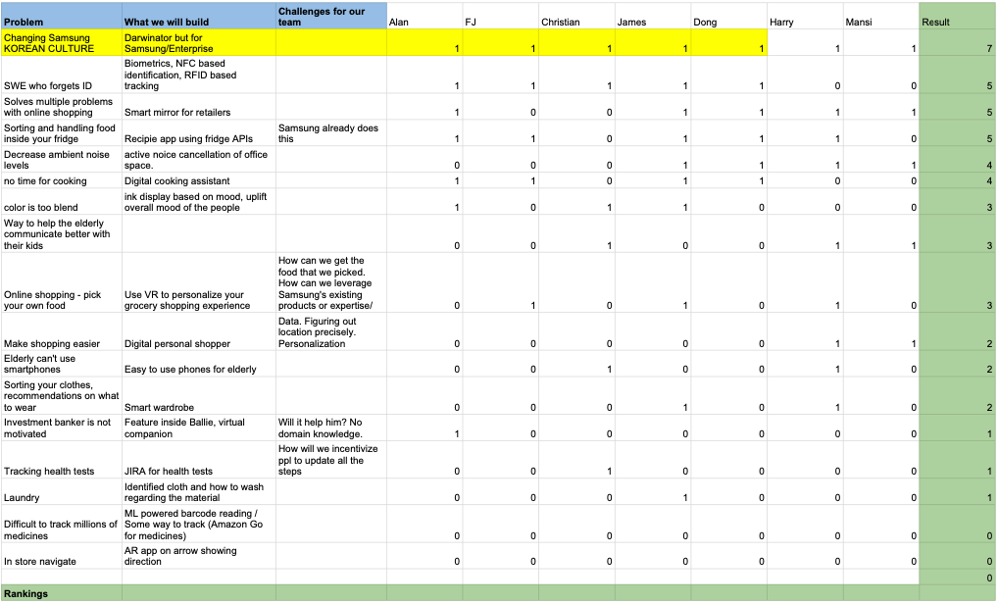
Appendix
Idea Filtering

Slide 13
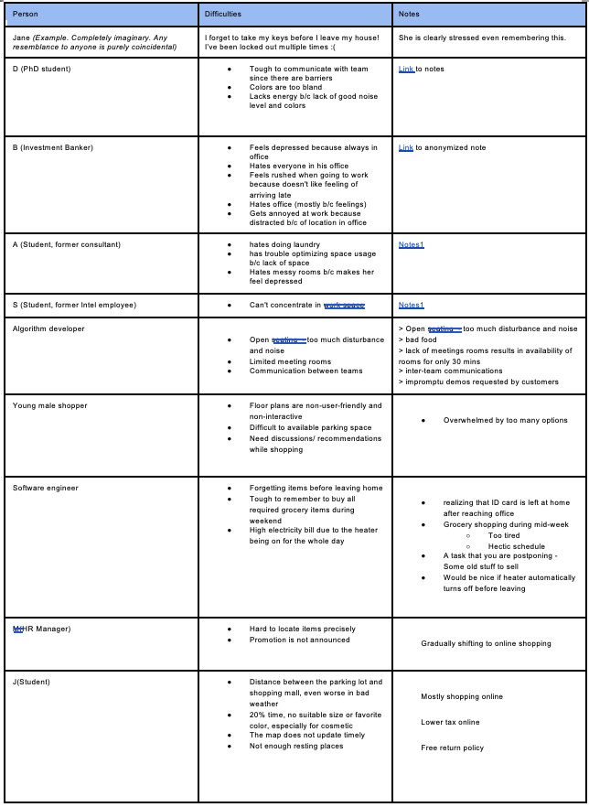
User Interview part 1

Slide 14
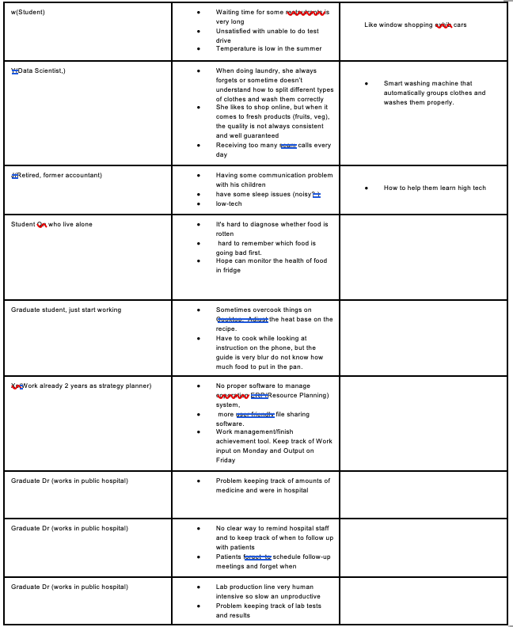
User Interview part 2

